Slide 2
Chapter 9
Cloud Infrastructure Management and Migration

Slide 3
Learning Outcomes
Comprehend various service creation tools
Describe the web application programming interface
Describe the unified management software
Understand cloud service management
Describe the way to access cloud
Understand cloud migration
Describe banking on cloud

Slide 4
Introduction
Virtualization is a key feature that supports cloud computing.
A cloud with a more virtualized infrastructure has higher resource utilization.

Slide 5
Administrating Clouds
Various suppliers possess products structured for cloud computing management, such as OpenQRM, Managed Methods, VMware, and Cloud Kick, together with established names such as CA, BMC, IBM, Tivoli, and HP.
The main features are provided by the main cloud substructure managing products which are as follows:
Almost all of these assist in designing and furnishing new items and in eliminating useless items.
Almost all offer a common set of reports on status such as response time, used quota, uptime, etc.
Almost all of these assist distinct clouds forms (often stated as hybrid clouds).

Slide 6
Administrating Clouds
Few suppliers present comprehensive means in handling metrics and managing provisioning in hybrid environments and they are Zeus, Morph, RightScale Kaavo, and Scalr.
Cloud suppliers offer certain options to meet the first and second standard, like CloudWatch by Web Services of Amazon.
HP company Open View, also known as Operating Manager, can administer cloud-based servers, but in the same way as administered by some other server.

Slide 7
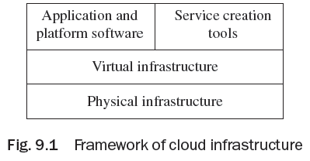
Cloud Management Products
The framework of cloud infrastructure is made up of the following components:
Physical infrastructure
Virtual infrastructure
Applications and platform software
Cloud infrastructure management and
service creation tools

Slide 8
Unified Management Software
Unified management software interrelates with all individual virtual infrastructure management software and gathers data on the accessible virtual and physical infrastructure patterns, connectivity, and consumption.
The vital purpose of unified management software is to generate cloud services.
Unified management software assists in classifying cloud services. It permits a manager to roll all the services together with their service traits.
Unified management software facilitates generating a variety of cloud services along with varied service traits.

Slide 9
Unified Management Software
Unified management comprises the following:
Automation of IT sequence with incorporation into accessible IT systems’ management tactics
Self-service portal and service catalog for IT resources along with on-demand provisioning
On-demand provisioning offered along with self-service portal and service catalog for IT resources
Resource management for efficient operation of hardware infrastructure groups
Automatic workload for carrying effectual batch and event-driven project business measures

Slide 10
Unified Management Software
Automatic workload for carrying effectual batch and event-driven project business measures
Life cycle management from request to retirement
Strategy-based administration destined for improved handling and governance
Virtual and physical assets administration
Automatic network provisioning
Automation and setting up for huge data and business enterprise aptitude workloads

Slide 11
Unified Management Software
Resource allocation comprises generating service cases and assigning resources from bundles to service cases when customers ask for services. At the occasion of generating service cases, VMs are built and incorporated with virtual volumes (virtual disks) and VLANs. Platform software and application can be deployed on the VMs. The service cases get storage, network, and compute capacity from suitable bundles. The allotment of aptitude and software deployment pursues traits described for the service.

Slide 12
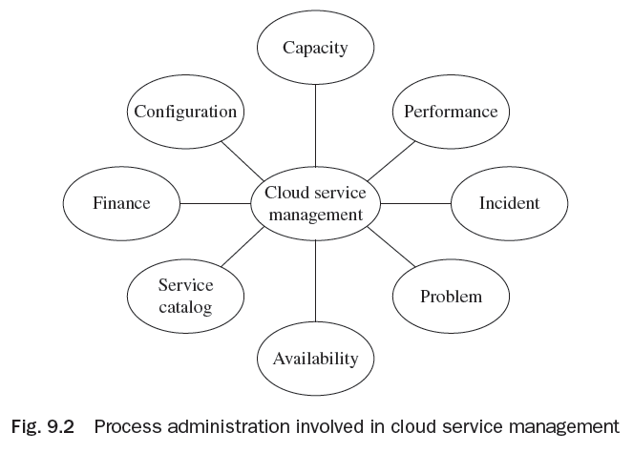
Processes in Cloud Service Management
Cloud service management procedures perform in the environment to make certain all the service tasks are carried out as committed. Processes included in cloud service management are:
Service benefit and configuration administration
Capacity administration
Performance administration
Incident administration
Problem administration
Availability administration
Service catalog administration
Financial administration
Compliance administration

Slide 13
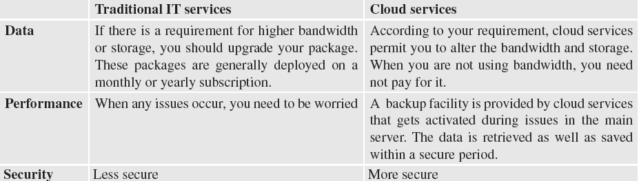
Differences between Traditional IT Services and Cloud Services

Slide 14
How to access the Cloud
For accessing the cloud, an Internet connection is required.
Every provider offers a certain function so that users can manage their clouds according to their form.
One can buy additional storage space at any time from the respective cloud provider according to technological requirements, thus the cloud provider will offer services on a pay-as-you-use method.
The tools required for accessing cloud services and tools are Platforms, Web Applications, Web Application Programming Interface, Web Browsers.

Slide 15
Migrating to Cloud
A corporation's aim of migrating to the cloud must be a clear perceptive of what the cloud may and may not do it.
A well-formed cloud policy needs thorough deliberation of every cloud service kind, installation module and access alternative considered against specific application characteristics of the company.
A full-grown immigration policy will be expected in various objects, but among these, three are the most vital—organizational customs, IT governance, and virtualization.

Slide 16
Advantages of Clouds
Scalable—Nearly all cloud-computing services are payable as per a monthly charge. Therefore, if your business expands, you may order additional server space.
Nearly zero provisioning cost—Along with the cloud, you need not establish a server and waste the man-hours it takes to get one, up and working.
Money can be saved for other means—It lessens the expenses involved in setting up a novel infrastructure.
Fewer IT infrastructure staff to administer—Along with cloud computing, you need not employ a technical group to administer and scrutinize the cloud.

Slide 17
Disadvantages of Clouds
Scarcity of control—Servers might not be directly administrated by you, but even now you are accountable for your data. Before deciding on a cloud service, you must inquire about the backup system, safety, and upholding policies. Decide what happens to your data if the company modifies hands or moves out of business, and understand that your company even possesses the information and may get it from the cloud whenever you need it.
Integrating systems—It is impossible for everybody to shift a corporation totally to the cloud due to the systems it has constructed already.

Slide 18
Disadvantages of Clouds
Speed—Along with the data transfer speed, cloud-based services sometimes do not communicate among themselves during low-speed connectivity.
Cost—As there is no up-front assets’ investment associated with cloud services, the technology is yet to have long-standing expenses’ investments. The expenses linked with downtime, renewing of native computers to access the system, and unavoidable unpredicted faults are all drawbacks for drifting to the cloud.

Slide 19
Challenges in Migration to and from the Cloud
Successful cloud migrations need adequate resources and time.
The three main dealers—Google, Microsoft, and Amazon,—control the cloud market, whereas most businesses use multiple dealers’ apps instead of asking employees to follow one set of devices.
With the lack of third-party support, controlling cloud apps might be a budget buster.
Safety remains the biggest obstacle to cloud adoption.
Although various businesses have made the jump to the cloud, almost one quarter is still uncertain to migrate—mainly because of concerns over safety.

Slide 20
Banking on Cloud Economics
The cloud computing module is a modern conception of computation which offers a number of advantages for its adopters, for example, that of the same physical infrastructure being easily shared by many users with virtualized infrastructure.
Such an online computing module has been broadly used in the western world and assumed to have some trade and financial effects.
For predicting the effects of the cloud computing acceptance, various models are built. Several strategy executions comprise the support of the cloud computing adoption in banks and universities for comprehending the advantage of efficient usage and scalability of computing resources.

Slide 21
Thank You!

